Slide 1


Demystifying
Mobile Pentesting:
From Tools to Tactics
Manuel Buslon | TESTER

Slide 2

Agenda
What is Mobile Penetration Testing?
Android example app
OWASP Mobile Application Security
Meeting JADX and Frida
Reverse engineering and app tampering

Slide 3


1
What is Mobile Penetration Testing?

Slide 4

2
Android example app

Slide 5




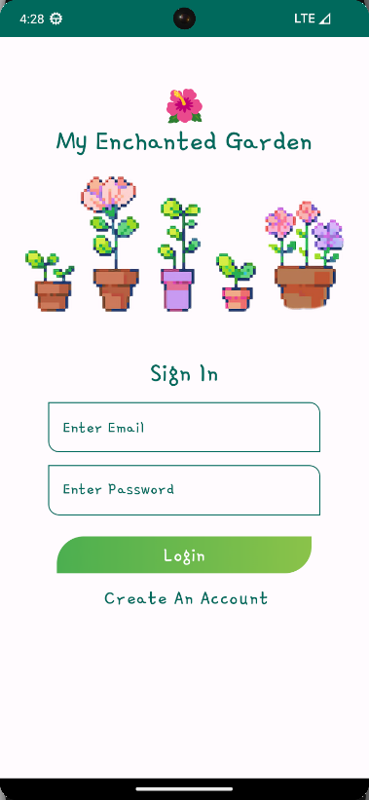


Tech Stack
My Enchanted garden

Slide 6


Tech Stack
My Enchanted garden Back End

Slide 7

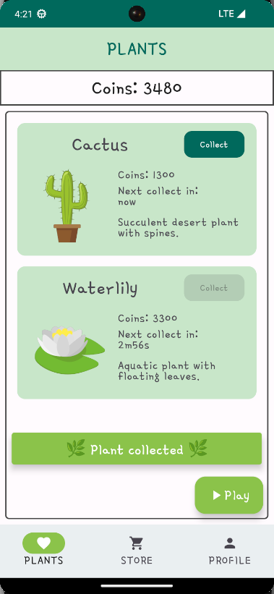
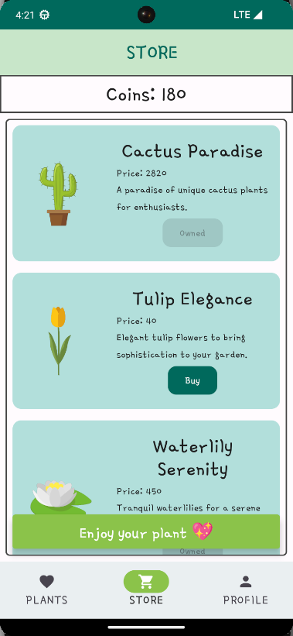
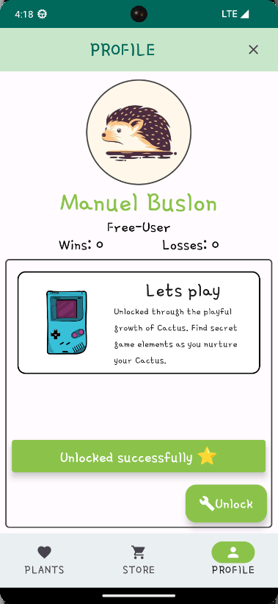
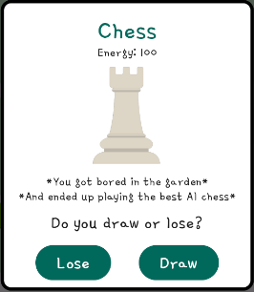
Demystifying Mobile Pentesting
Features
Chess
Plants
Store
Achievements

Slide 8

Demystifying Mobile Pentesting
Features
Chess
Plants
Store
Achievements

Slide 9
3
OWASP Mobile Application Security

Slide 10
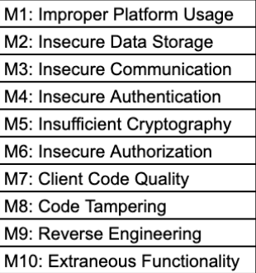
Demystifying Mobile Pentesting
OWASP Mobile
M8
Code Tampering
M9
Reverse engineering
M10
Extraneous Functionality

Slide 11
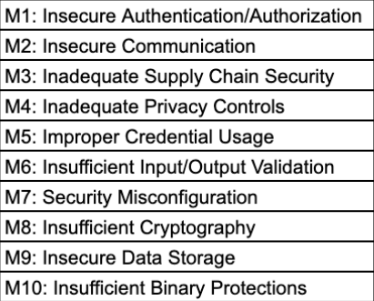
Demystifying Mobile Pentesting
OWASP Mobile
M10
Insufficient Binary Protections

Slide 12

Demystifying Mobile Pentesting
Insufficient Binary Protections
Information Theft
Intellectual Property Theft
Backend Vulnerability Exploration
Feature Manipulation
Security Bypass
Malicious Code Injection

Slide 13


Demystifying Mobile Pentesting
What could happen?
* The best feature *

Slide 14

Demystifying Mobile Pentesting
What could happen?
* The best feature *

Slide 15

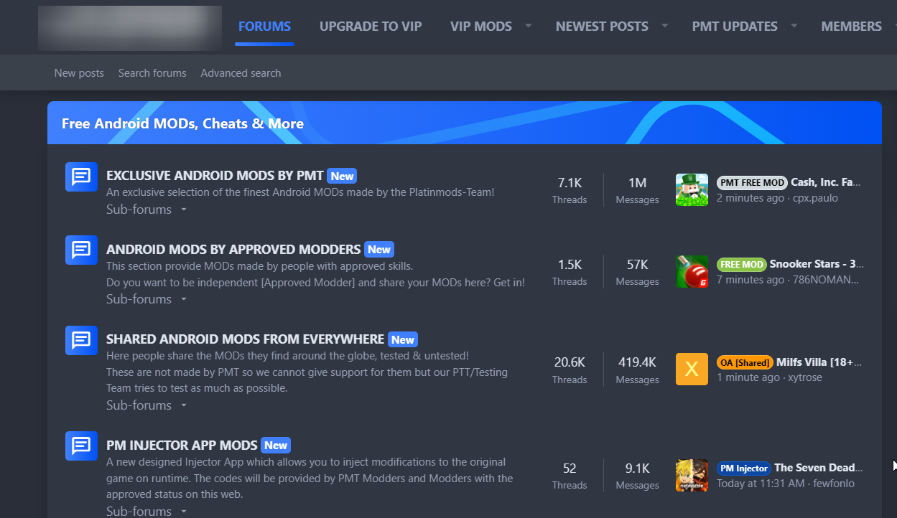

Demystifying Mobile Pentesting
Third party stores

Slide 16
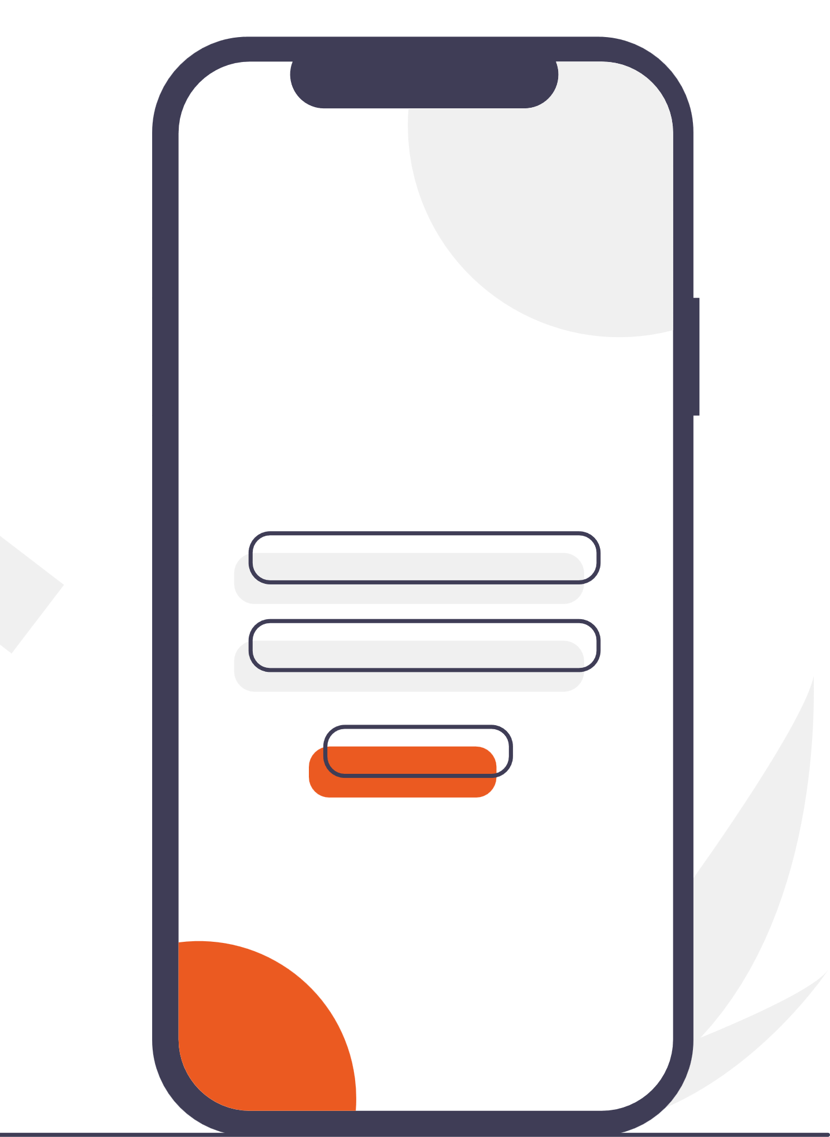

Demystifying Mobile Pentesting
Information theft
* Pirate hedgehog stealing your information *

Slide 17
Demystifying Mobile Pentesting
Requests
Responses
Methods
& Functions
What can we modify?
Classes
Screens
&
Render
Add code

Slide 18
Demystifying Mobile Pentesting
The app
What can we modify?

Slide 19
4
Meeting JADX and Frida

Slide 20
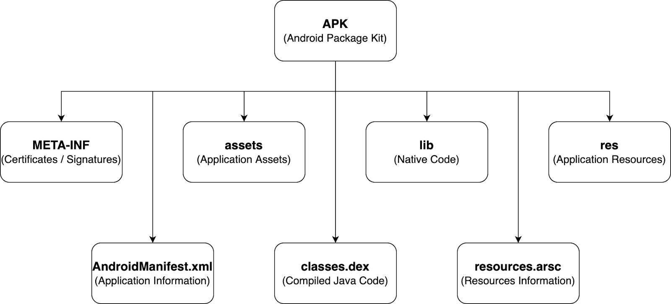
Demystifying Mobile Pentesting
Android App Architecture

Slide 21
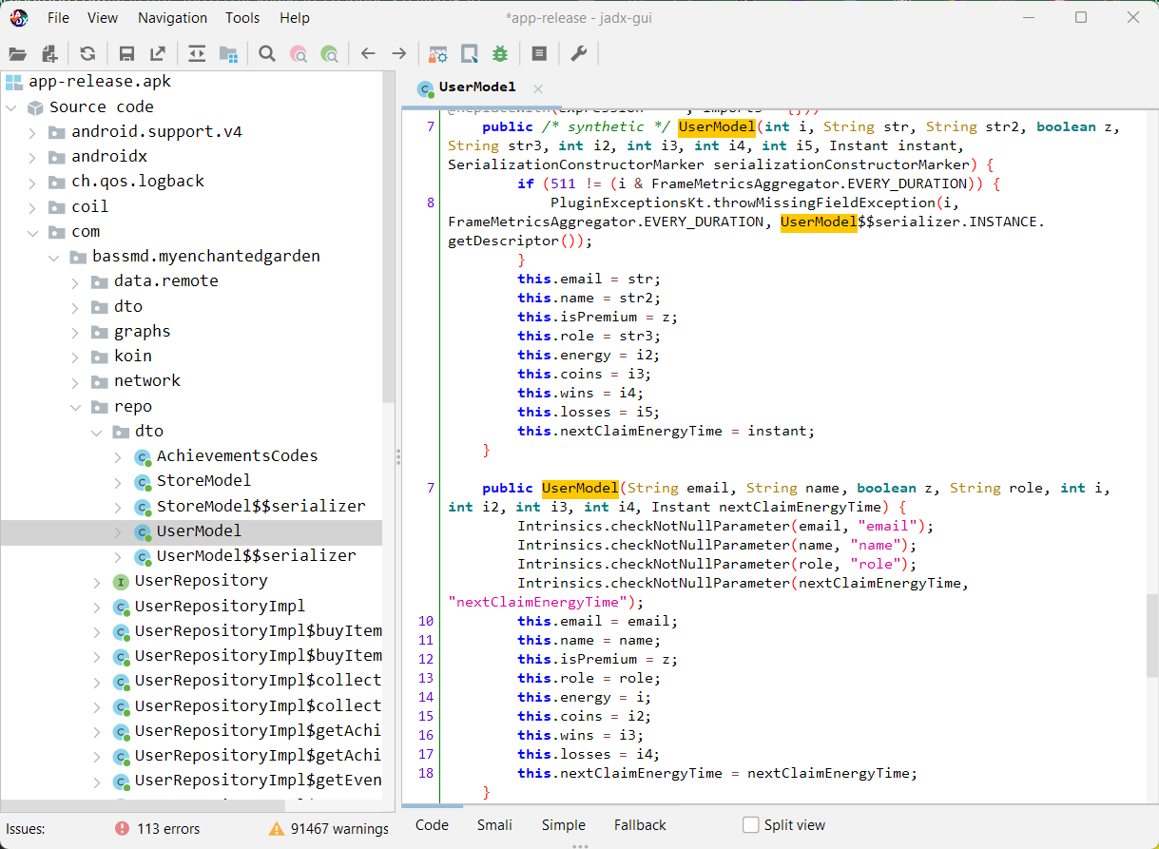

Demystifying Mobile Pentesting
JADX
Command line and GUI tools for producing Java source code from Android Dex and Apk files
skylot/jadx: Dex to Java decompiler (github.com)

Slide 22
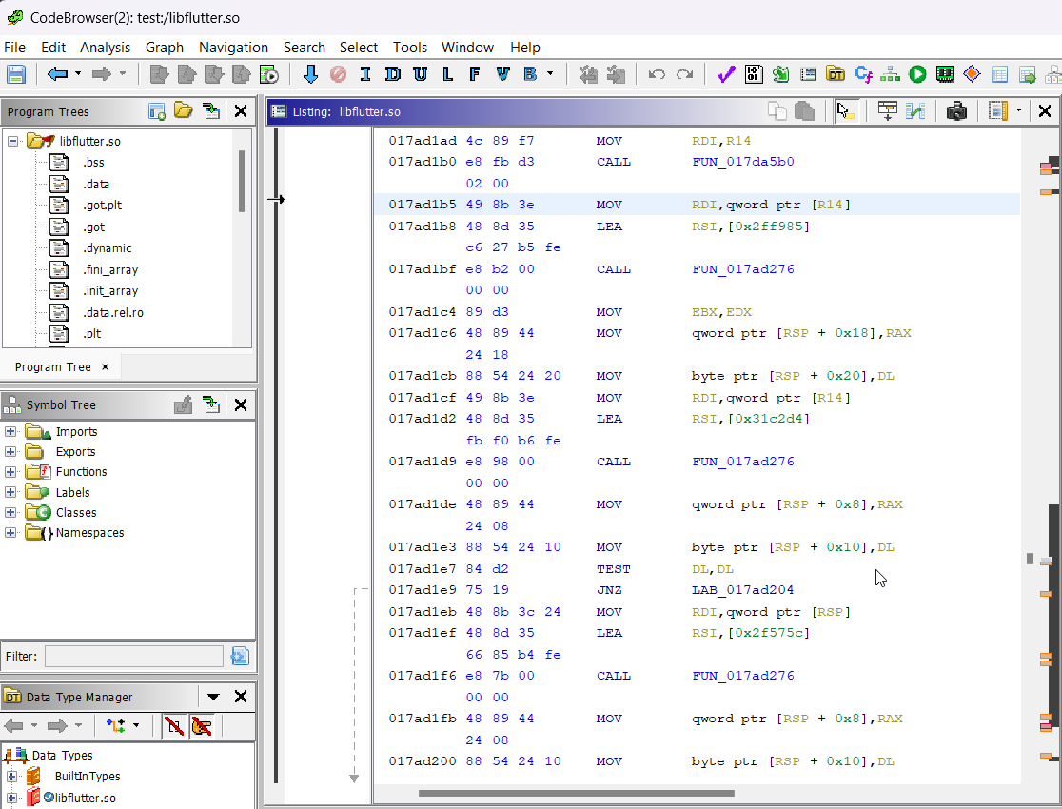


Demystifying Mobile Pentesting
Ghidra
A software reverse engineering (SRE) suite of tools developed by NSA's Research Directorate in support of the Cybersecurity mission

Slide 23

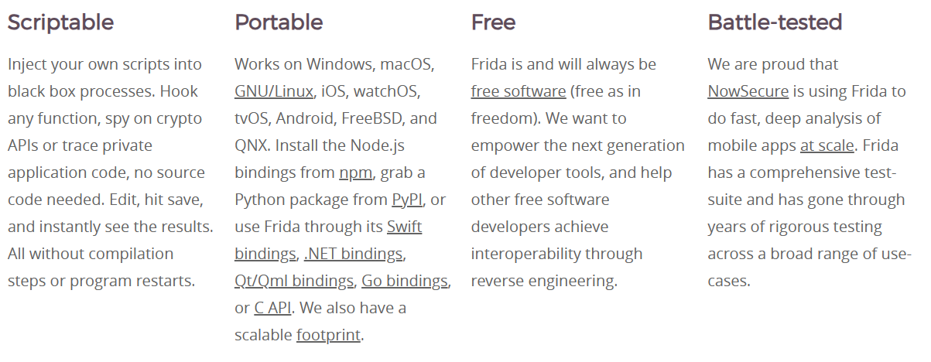
Demystifying Mobile Pentesting
Frida
Dynamic instrumentation toolkit for developers, reverse-engineers, and security researchers.
https://frida.re/

Slide 24

Demystifying Mobile Pentesting
Frida
Dynamic instrumentation toolkit for developers, reverse-engineers, and security researchers.
https://frida.re/

Slide 25
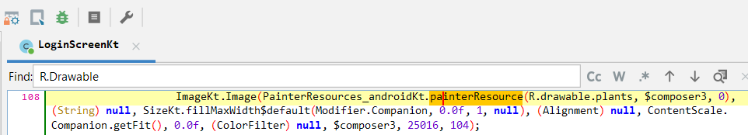
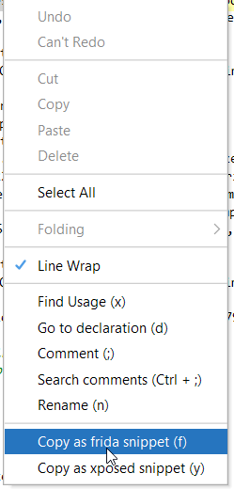
Demystifying Mobile Pentesting
Frida
Dynamic instrumentation toolkit for developers, reverse-engineers, and security researchers.
https://frida.re/

Slide 26

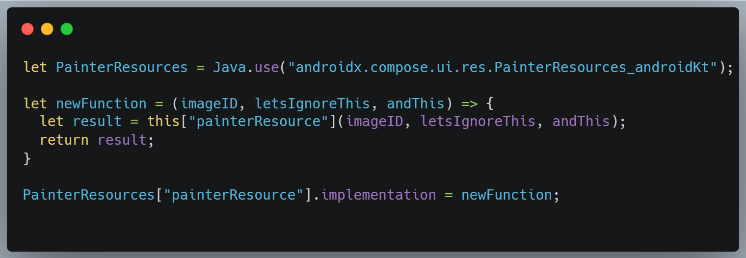
Demystifying Mobile Pentesting
Frida
Dynamic instrumentation toolkit for developers, reverse-engineers, and security researchers.
https://frida.re/

Slide 27
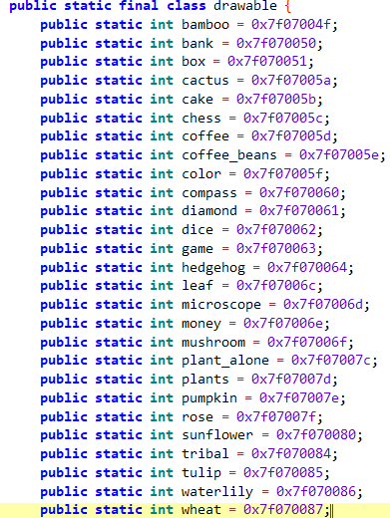
Demystifying Mobile Pentesting
Frida
Dynamic instrumentation toolkit for developers, reverse-engineers, and security researchers.
https://frida.re/

Slide 28
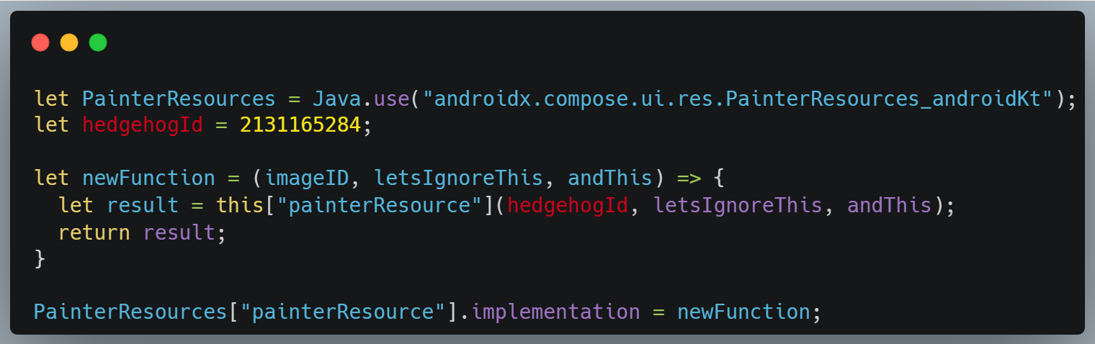
Demystifying Mobile Pentesting
Frida
Dynamic instrumentation toolkit for developers, reverse-engineers, and security researchers.
https://frida.re/

Slide 29
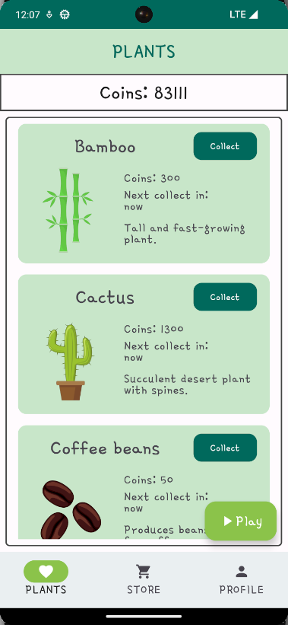
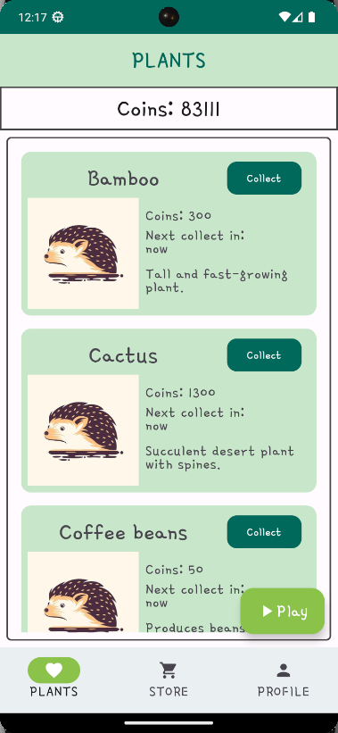
Demystifying Mobile Pentesting
Frida
Dynamic instrumentation toolkit for developers, reverse-engineers, and security researchers.
https://frida.re/

Slide 30
Demystifying Mobile Pentesting
Frida for testing
It can help us to observe and mock:
Requests
Responses
Methods
& Functions calls
Dynamic instrumentation toolkit for developers, reverse-engineers, and security researchers.
https://frida.re/
Classes
Screens
&
Render
Skip flows and automate actions

Slide 31
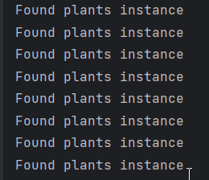
Demystifying Mobile Pentesting
Frida for testing
Dynamic instrumentation toolkit for developers, reverse-engineers, and security researchers.
https://frida.re/

Slide 32
5
Reverse engineering and app tampering

Slide 33
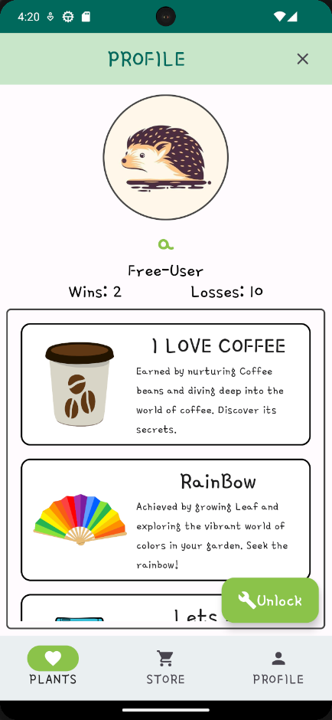
Demystifying Mobile Pentesting
Features
Chess
Plants
Store
Achievements

Slide 34
Demystifying Mobile Pentesting
Target Features
Chess
Plants
Store
Achievements

Slide 35
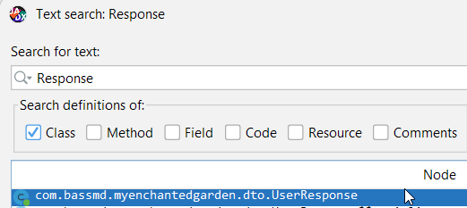
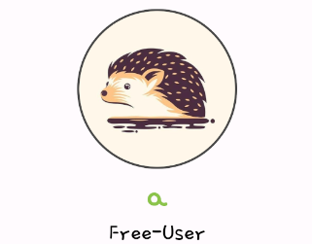
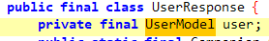
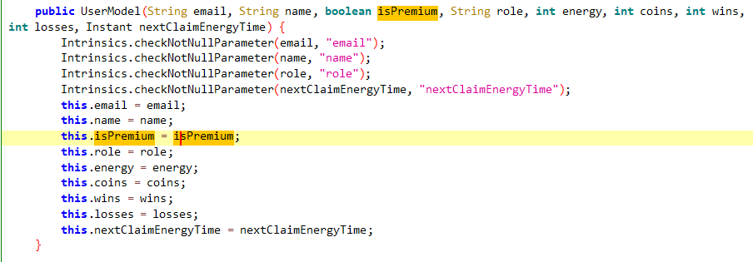
Demystifying Mobile Pentesting
Premium

Slide 36
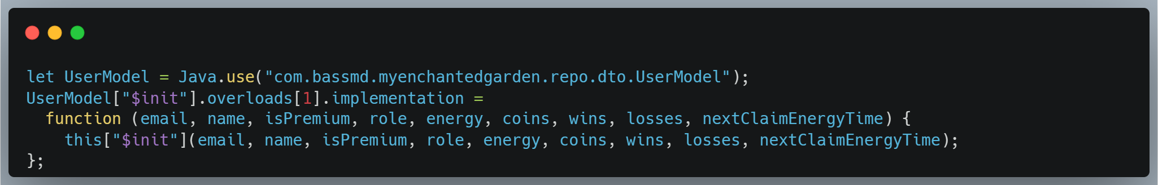
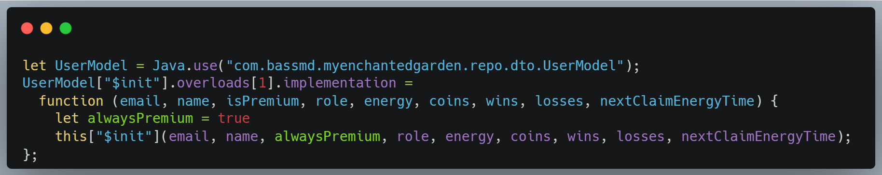
Demystifying Mobile Pentesting
Premium

Slide 37
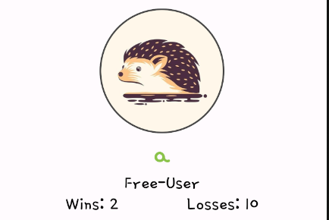
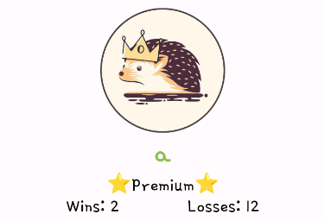
Demystifying Mobile Pentesting
Premium

Slide 38
Demystifying Mobile Pentesting
1
Unlock all achievements
2
Steal user credentials
3
Hedgehogs on every image
Other examples:
4
Show message
5
Always win chess
6
Take ownership of the app

Slide 39
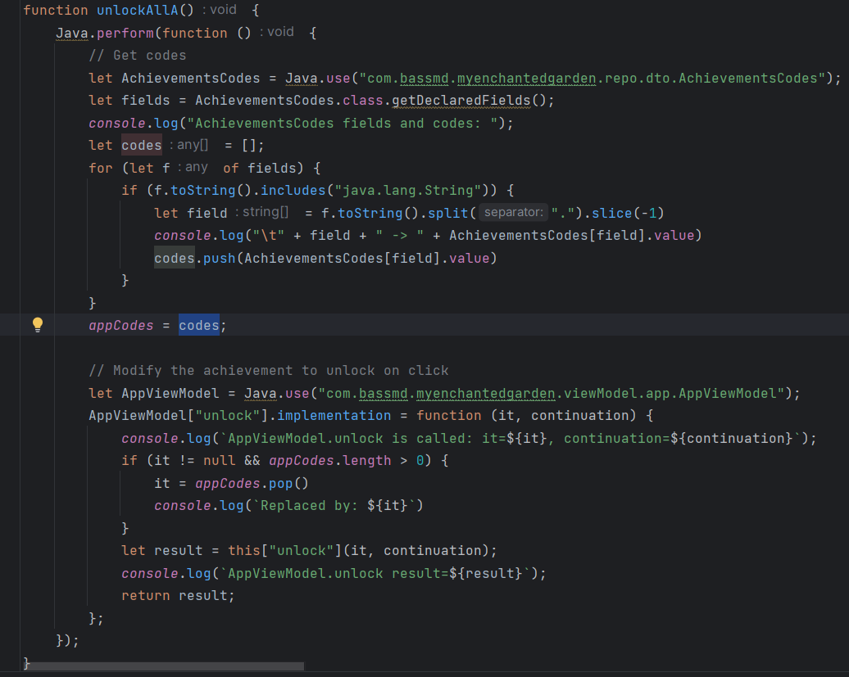
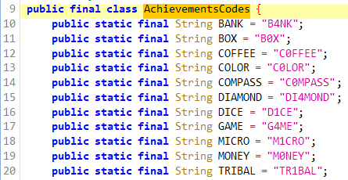
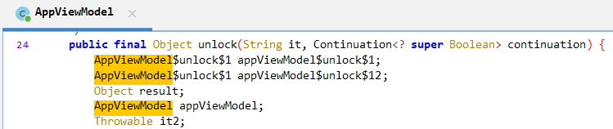
Demystifying Mobile Pentesting
Unlock all achievements

Slide 40
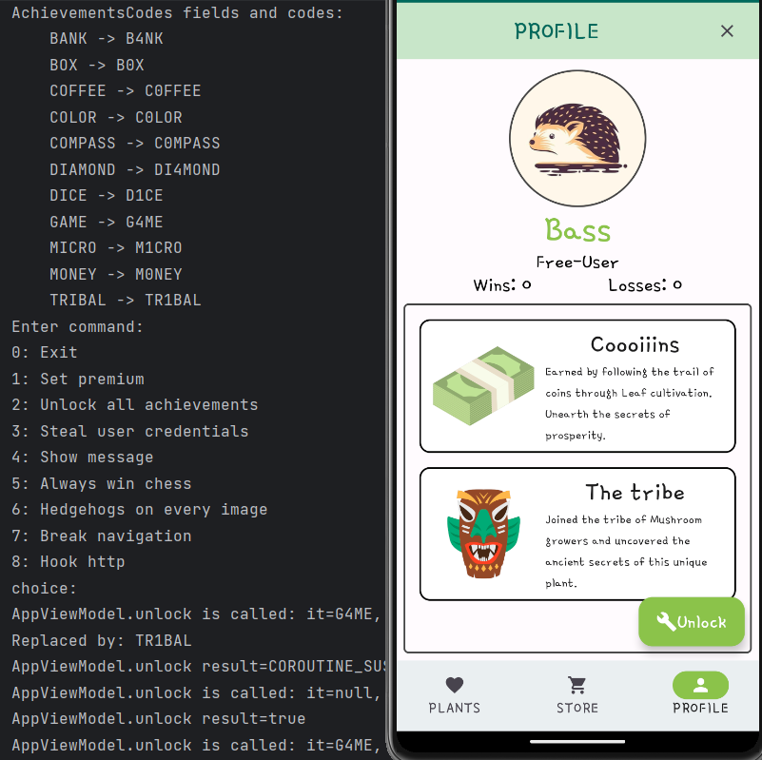
Demystifying Mobile Pentesting
Unlock all achievements

Slide 41
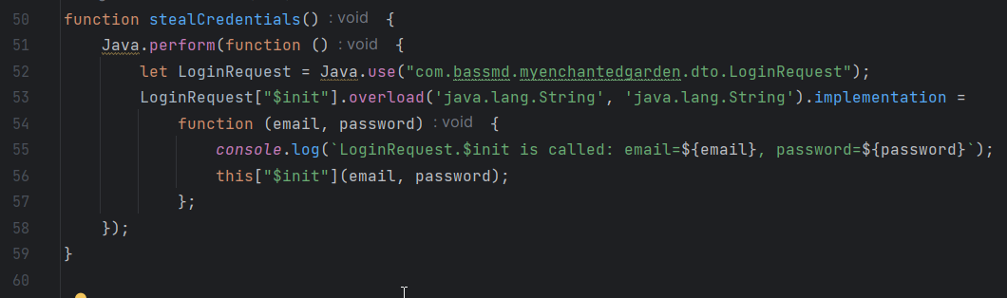
Demystifying Mobile Pentesting
Steal user credentials
//TODO: Replace console log with send credentials to the stealer server

Slide 42
Q&A
Thank You!

